Slide 1
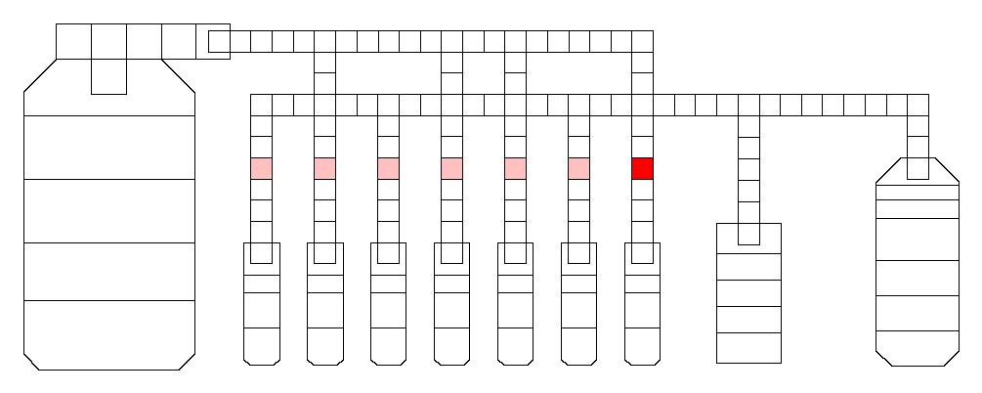
Bust lane issues
http://baebies-dev/fridge/run/6391 10/26/2017

Slide 2
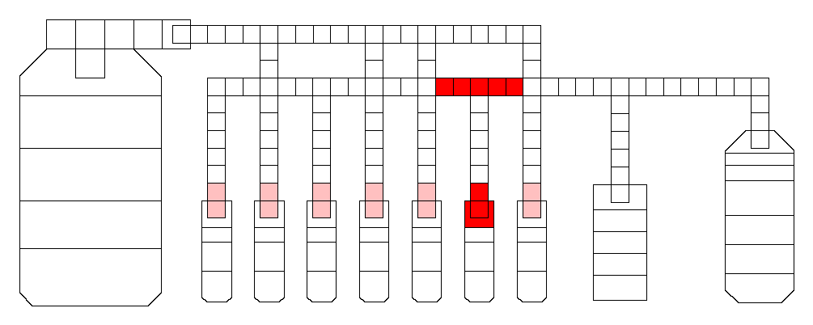
Transporting and dispensing issues
http://baebies-dev/fridge/run/6407 10/31/217

Slide 3
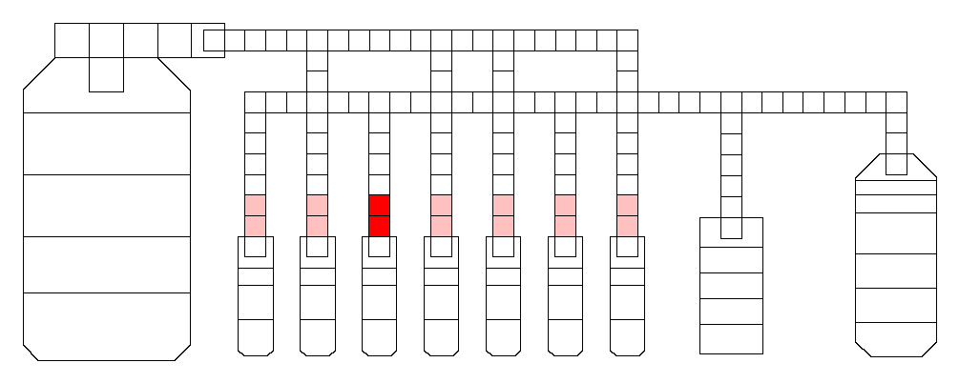
Dispense issue – Lane 5
http://baebies-dev/fridge/run/6450 11/06/2017

Slide 4
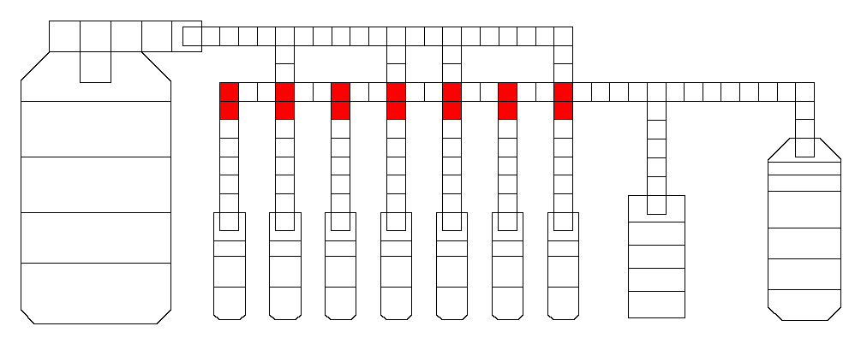
Drop split issues
http://baebies-dev/fridge/run/6511 11/10/2017

Slide 5
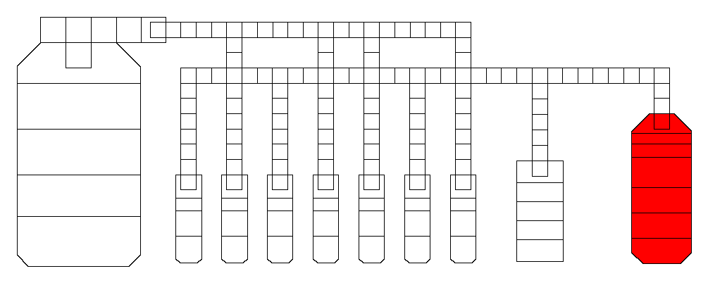
Reservoir dispense issue
http://baebies-dev/fridge/run/6530 11/15/2017

